Slide 1

In the name of
God
Notes:
To use this title animation slide with a new image simply 1) move the top semi-transparent shape to the side, 2) delete placeholder image, 3) click on the picture icon to add a new picture, 4) Move semi-transparent shape back to original position, 5) Update text on slide.

Slide 2
occupations
Related to ERP
professor:
Dr. Hakim
Kaveh Faraji -Mahmoud Rashidi Mohammad Chalabi

Slide 3
“Good people can make a bad system work; bad people can’t make a good system work”
-The Reengineering Handbook
Raymond L. Manganelli,
Mark M. Klein

Slide 4
INTRODUCTION
Our mission
In this presentation, we try to show you:
How many jobs we have in ERP life cycle?
What are the goals for which jobs?
Which specialties do we need in which position?
And tell you all story about them.
An ERP project typically goes through the life cycle stages.
But first you should hear our story about the creation of ERP in organizations …

Slide 5
PREPARE
Do you know anything about the creation of an ERP in an organization?
“project planning stage”
Business needs, Define the scope, Define TO BE process and document AS IS process, Select the project team, Estimate the cost
“project execution stage”
Requirement Validation, vendor selection, ERP solution finalization, Implementation Strategy(Technical Planning) and roadmap, Change Management Strategy(End user training plan)
“go live stage”
End user training and system testing, data Migration, Go live

Slide 6
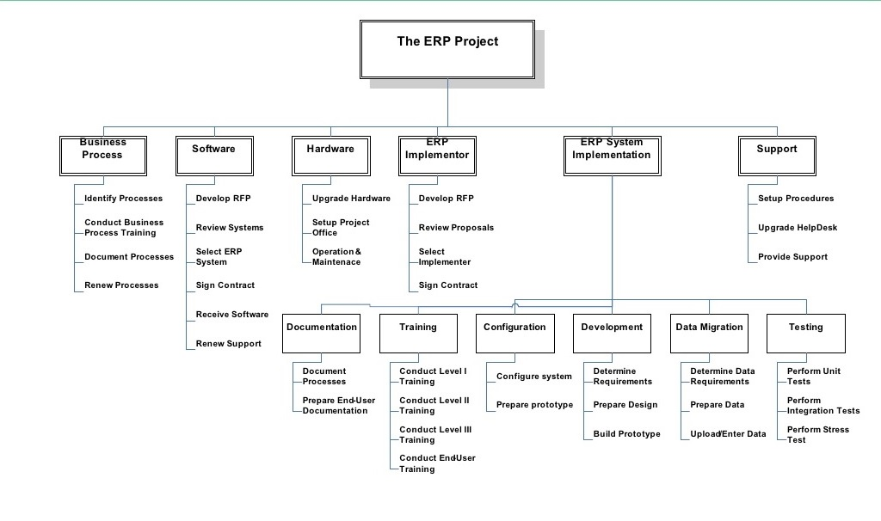

Slide 7


Slide 8
Executive Steering Committee
ERP
project
Project Management Team
Implementation
Group 1
Implementation
Group 2
Implementation
Group 3

Slide 9

1
Subject matter expert:
Responsibilities:
Analyzes process gaps & establish best practices for business processes
Ensures functional requirements are configured with opportunity for future enhancement
Ensures end users are being trained & are prepared for new ERP system
Supports and resolves operational issues without impacting business opportunity
Ensures smooth implementation with no interruption to business towards go-live schedules
Participates in ERP upgrades and co-ordinate global enhancement of ERP with regional teams
Knowledge / Skills / Abilities:
Technical Training in Information Assurance Information Technology
Network Design
Strategic Planning
Executive Steering Committee
Project Sponsor:
owner of ERP project
senior executive
representative of the organization
leadership
Responsibilities:
creating the business case for the project
ensuring that the project is properly launched
establishing the project roles and reporting structure
ensuring the project is under control
resolving issues that are beyond the control of the Project Manager
resolving conflict and removing obstacles to progress
Project Sponsor
Business Owners
Subject matter expert
Internal Experts
External Experts
Stakeholders

Slide 10

3. Project Client:
activities:
Prepare and conduct customer - vendor meetings
Support and accept the planning of the Implementation phase
Review and support decision for the project scope
Acceptance of implementation proposal
Initiate project planning of all project phases
Assign adequate resources to the project
Manage the defined budget and budget changes
Ensure customer acceptance for delivered services
Hand over to support team
3. Executive Sponsors:
Responsibilities:
Remove roadblocks
Help the project team understand the alignment of the project to the organization’s strategy
Champion the project or program
Add resources when appropriate
Act quickly to resolve issues
3. Subject Matter Expert:
Responsibilities:
Support the definition of business processes
Determine and support the implementation of a business policy
Oversee the execution of that policy via business rules applied
Review the results of testing and simulation
Resolve business issues relating to business rule execution
Knowledge / Skills / Abilities:
They may work on different types of projects and have slightly different duties, but their role is essentially to ensure the facts and technical details are correct.
2
3. project manager:
Responsibilities:
defining project scope and budget
coordination between all project stakeholders
Coordinating/Leading with a diverse team
Tracking completion of action items
Creating and managing all related program/project documentation
Documenting current and future state workflows and processes
Knowledge / Skills / Abilities:
Great collaborator with the stakeholders in finding strategic solutions
Strong analytical, multi-tasking, technical, and organizational skills
Demonstrates superior oral and written communication skills
Exceptional interpersonal and customer service skills
Demonstrates ability to contribute positively in a team environment.
3. Project Champion:
Responsibilities:
Identifying a project’s strategic objectives
Critically analyzing and ensuring best practices
Identifying and eliminating obstacles that may threaten a
Prioritizing project phases based on value
Knowledge / Skills / Abilities:
Capacity to meet and exceed expectations of management
Ability to motivate and inspire a team to buy in and become engaged in the project’s success
Finesse to negotiate with all parties to ensure project success
Exceptional problem solving abilities and the resourcefulness to defeat obstacles
Superior organizational talents, and a knack for keeping team members on track.
Stellar communications skills, keeping all project stakeholders aware and engaged.
Project management team
Executive Sponsors
Project Champion
Project Manager
Project Customer/Client
Subject Matter Expert

Slide 11

3
ERP software Developer:
Responsibilities:
Day to day application, support
Implementation of ERP updates and enhancements
Trouble shoot and resolve related issues through development of software
Brainstorm with a cross functional team to provide business alternatives
Train employees on the continued use of software
Knowledge / Skills / Abilities:
High level, hands on experience with all aspects of ERP
SQL scripting and reporting experience
Business process owner:
Responsibilities:
Defines the process mission, vision, tactics, goals, objectives
Synchronizes process improvement plans with other process owners within the value chain and other interfacing processes
Ensures appropriate process designs, including the correct business requirements
Defines and sponsors business process change and capability investments
Knowledge / Skills / Abilities:
Process Management
Process Improvement
Process Design
Analyzes and Solves Problems
Communicates and Persuades
Stakeholder Engagement
Team working
Technical Consultant:
Responsibilities:
Understands business process and relates knowledge to product functionality
Works toward proficiency in practice technology. Gains better understanding of business process
Learns to define business requirements for technical solutions or alternatives
Assists consultant with leading project teams through design workshops and pilot environments
Assists with developing data conversion and testing strategies
Knowledge / Skills / Abilities:
Bachelor’s Degree in Accounting, Business with an Accounting focus, MIS, Supply Chain Management
Proficient in Microsoft Office applications
Excellent communication and relationship building skills
Excellent problem solving and analytical skills
Strong time management and organizational skills
Functional Consultant:
Responsibilities:
Consult with internal product managers and implementation specialists
Coordinate and collaborate with internal product managers and implementation specialists, and external end users
Produce technical documentation for the development team to support project delivery
Monitor and report on project progress, and advise managers and stakeholders of potential project delays
Knowledge / Skills / Abilities:
Proven professional with advanced understanding of accounting theory
Strong organizational and time management skills
Ability to resolve complex problems positively
Excellent interpersonal, decision-making and analytical abilities
experience with Accounting, ERP, or other business management software
Experience with software in a SaaS environment
Implementation group
Business process owner
Key user
ERP software Developer
Functional Consultant
Technical Consultant
11
ERP software Developer:
Responsibilities:
Day to day application, support
Implementation of ERP updates and enhancements
Trouble shoot and resolve related issues through development of software
Brainstorm with a cross functional team to provide business alternatives
Train employees on the continued use of software
Knowledge / Skills / Abilities:
High level, hands on experience with all aspects of ERP
SQL scripting and reporting experience
Notes:
Tip:
When using complex image as full-bleed background add a transparency (70%-90%) fill layer to give contrast to text.

Slide 12
Reference
Books:
Integrated learning for ERP success : a learning requirements planning approach / by Karl M. Kapp ; with William F. Latham and Hester Ford-Latham.
Enterprise Resource Planning, Fundamentals of Design and Implementation/ by K. Ganesh; Sanjay Mohapatra; S.P. Anbuudayasankar, P. Sivakumar.
Enterprise Resource Planning, Corporate, Governance and Internal Auditing/ by Hany Elbardan, Ahmed Othman, Rashwan Kholeif.
Modern ERP, select, implementation, & use today’s advanced business systems, third edition/ by Marianne Bradford.
Concepts in Enterprise Resource Planning, Fourth Edition/ by Ellen F. Monk and Bret J. Wagner.

Slide 13
Reference
Articles:
Actors’ interaction in the ERP implementation literature/ by Bambang Purwoko, Kusumo Bintoro, Togar Mangihut Simatupang, Utomo Sarjono Putro, Pri Hermawan.
Perceived Effects of ERP on Jobs and Work in a Contact Center/ by Charles H. Davis.
Success Factors in Enterprise Resource Planning (ERP) Systems Implementation/ By Abdel-Rahman Ismail, PhD MIS.
And a lot of job descriptions that we found for this presentation.

Slide 14
Reference
sites:
https://www.bistasolutions.com
https://www.gartner.com
https://www.infotech.com

Slide 15
THANK YOU

